Slide 1
LESSON 3
BOOK CHAPTER 23
GAUSS’ LAW
And
BOOK CHAPTER 24
ELECTRIC POTENTIAL

Slide 2
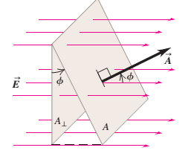
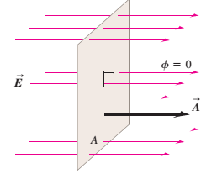
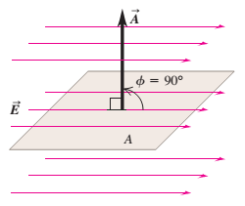


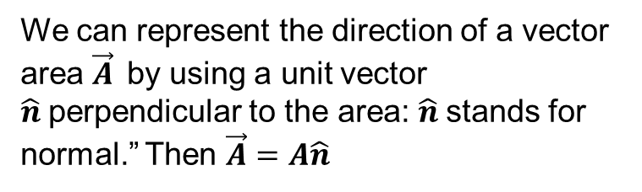


Electric Flux:
The electric flux $Φ$ through a surface is the amount of electric field that pierces the surface.
Electric Flux for uniform $\vec{E}$and through a flat surface (open plane):
The electric flux $φ$ through the flat surface equals the scalar product of the electric field $\vec{E}$ and the area vector $\vec{A}$.
We can represent the direction of a vector area $\vec{A}$by using a unit vector $\hat{n}$perpendicular to the area: $\hat{n}$stands for normal.” Then $\vec{A}=A\hat{n}$
That is, $Φ=\vec{E}.\vec{A}$
We can write as $φ=EAcosφ$
$φ=EAcos{90}^{0}=0\frac{N−m^{2}}{C}$
$φ=EAcos0^{0}=EA$

Slide 3
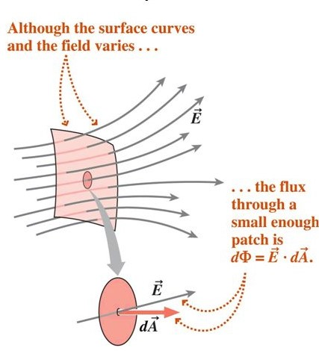
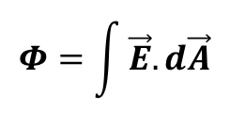
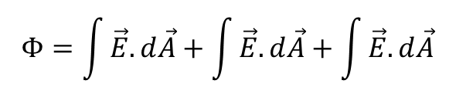
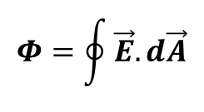
Electric Flux for nonuniform $\vec{E}$and through a curved surface:
When the surface is curved and field is nonuniform, we calculate the flux by dividing the surface into small (differential) patches (areas) dA, so that each differential area is essentially flat and field is uniform over each patch.
The total flux through the surface is given by
$$Φ=\int{\vec{E}. d\vec{A}}$$
where the integration is carried out over the surface.
Electric Flux through a closed surface:
The net flux through a closed surface is given by by
$$Φ=\oint{\vec{E}.d\vec{A}}$$
$$Φ=\int{\vec{E}.d\vec{A}+\int{\vec{E}.d\vec{A}+\int{\vec{E}.d\vec{A}}}}$$
where the integration is carried out over the entire surface.

Slide 4
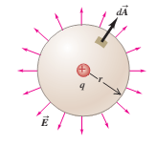
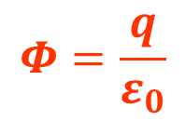
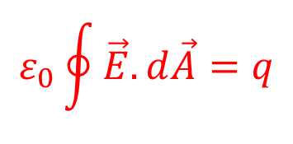
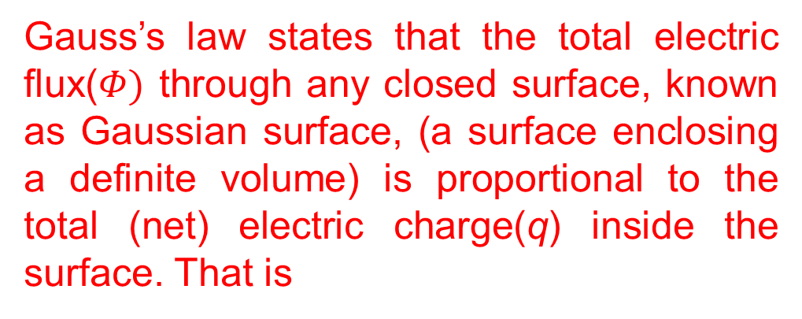

Gauss’ law:
Gauss’s law is an alternative to Coulomb’s law. While completely equivalent to Coulomb’s law, Gauss’s law provides a different way to express the relationship between electric charge and electric field. It was formulated by Carl Friedrich Gauss(1777–1855), one of the greatest mathematicians of all time.
Gauss’s law states that the total electric flux($Φ)$ through any closed surface, known as Gaussian surface, (a surface enclosing a definite volume) is proportional to the total (net) electric charge(q) inside the surface. That is
$$Φ=\frac{q}{ε_{0}}$$
We can write the above form as
$$ε_{0}Φ=q$$
Gaussian surface
$$ε_{0}\oint{\vec{E}.d\vec{A}}=q$$

Slide 5
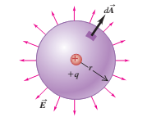
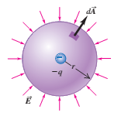
Gaussian surface around negative charge:
negative (inward) flux
Gaussian surface around positive charge:
positive (outward) flux

Slide 6
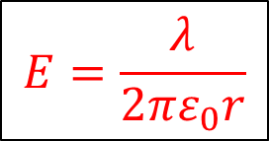
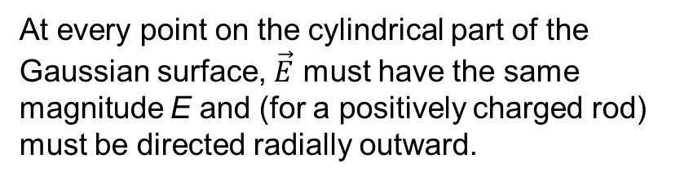
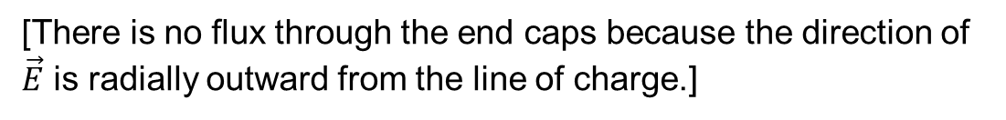



Applying Gauss’ Law: Cylindrical Symmetry:
An infinitely long cylindrical plastic rod with a uniform charge density λ
We choose a circular cylinder of radius r and length h, coaxial with the rod.
Because the Gaussian surface must be closed, we include two end caps as part of the surface.
At every point on the cylindrical part of the Gaussian surface, $\vec{E}$ must have the same magnitude E and (for a positively charged rod) must be directed radially outward.
Using Gauss’ law, we can write
$$ε_{0}Φ=q=λh$$
[λ is the liner charge density
(charge per unit length) of the rod]
$$ε_{0}EA=λh$$
[There is no flux through the end caps because the direction of $\vec{E}$ is radially outward from the line of charge.]
$$E=\frac{λ}{2πε_{0}r}$$
$$ε_{0}E(2πrh)=λh$$
Finally,

Slide 7

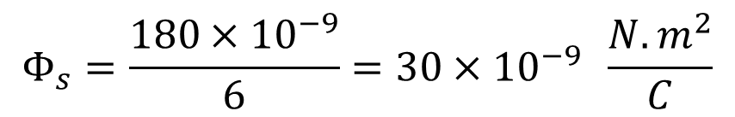
Problem 5 (book chapter 23)
A proton is a distance dl2 directly above the center
of a square of side d. What is the magnitude of the
electric flux through the square? (Hint:Think of the
square as one face of a cube with edge d.)
Answer:
Consider a cube consisting with six square faces; each of edge d. Thus, the proton is enclosed by the cubical Gaussian surface.
Electric flux through the cubical Gaussian surface is
$$Φ=\frac{q}{ε_{0}}=\frac{e^{+}}{ε_{0}}=\frac{1.6×{10}^{−19}}{8.854×{10}^{−12}}=0.18×{10}^{−7}=180×{10}^{−9} \frac{N.m^{2}}{C}$$
Electric flux through a face (a square) of a cube is
$$Φ_{s}=\frac{180×{10}^{−9}}{6}=30×{10}^{−9} \frac{N.m^{2}}{C}$$

Slide 8
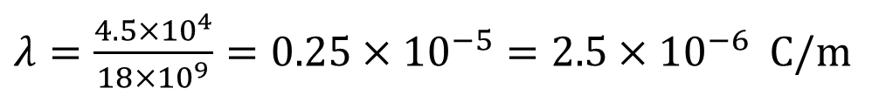
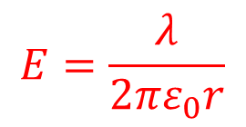
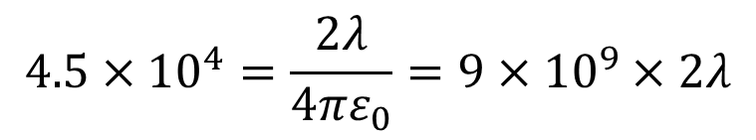



Problem 25 (Book chapter 23
An infinite line of charge produces a field of magnitude $4.5×{10}^{4} N/C$ at distance 2.0 m. Find the linear charge density.
Answer:
Required formula:
Given,
$$E=\frac{λ}{2πε_{0}r}$$
$$E=4.5×{10}^{4} N/C$$
$$r=2.0 m$$
$$4.5×{10}^{4}=\frac{2λ}{4πε_{0}}=9×{10}^{9}×2λ$$
$$λ=?$$
$λ=\frac{4.5×{10}^{4}}{18×{10}^{9}}=0.25×{10}^{−5}=2.5×{10}^{−6}$C/m

Slide 9
BOOK CHAPTER 24
ELECTRIC POTENTIAL

Slide 10


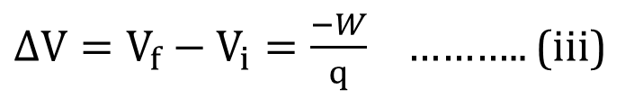
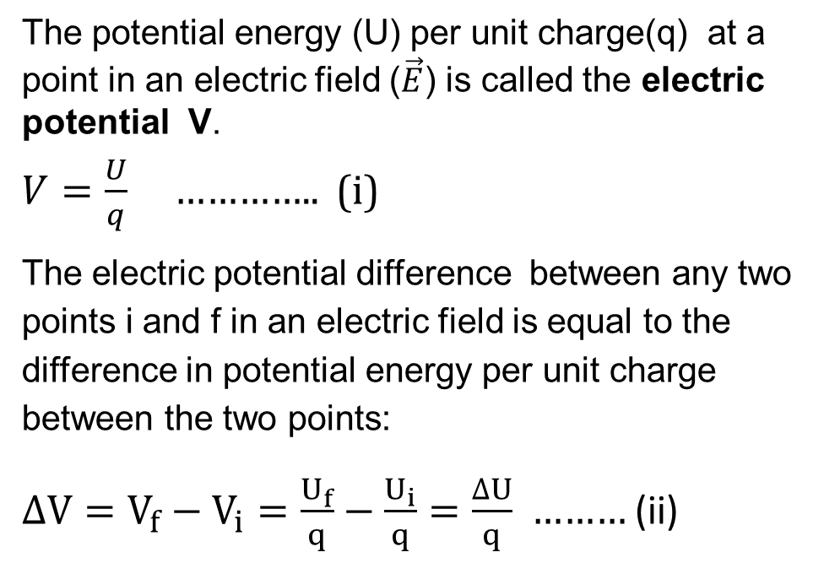

Electric Potential
The potential energy (U) per unit charge(q) at a point in an electric field ($\vec{E}$) is called the electric potential V.
$V=\frac{U}{q}$ ………….. (i)
The electric potential difference between any two points i and f in an electric field is equal to the difference in potential energy per unit charge between the two points:
$∆V=V_{f}−V_{i}=\frac{U_{f}}{q}−\frac{U_{i}}{q}=\frac{∆U}{q}$ ……… (ii)
U
i
+q
+q
f
$$\vec{E}$$
$$\vec{E}$$
$$\vec{E}$$
$$\vec{E}$$
$$\vec{E}$$
we can define the potential difference between points i and f as
$∆V=V_{f}−V_{i}=\frac{−W}{q}$ ……….. (iii)

Slide 11
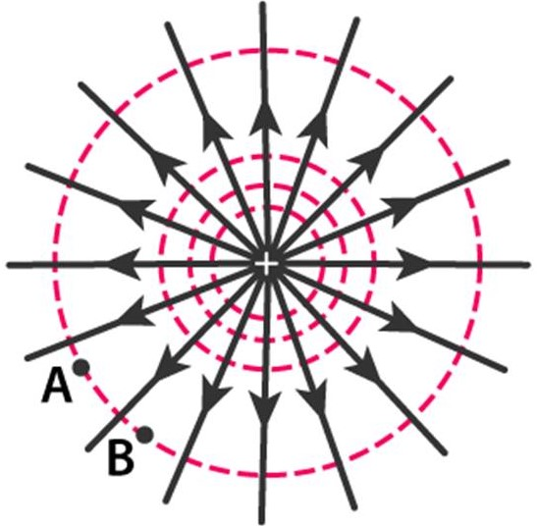
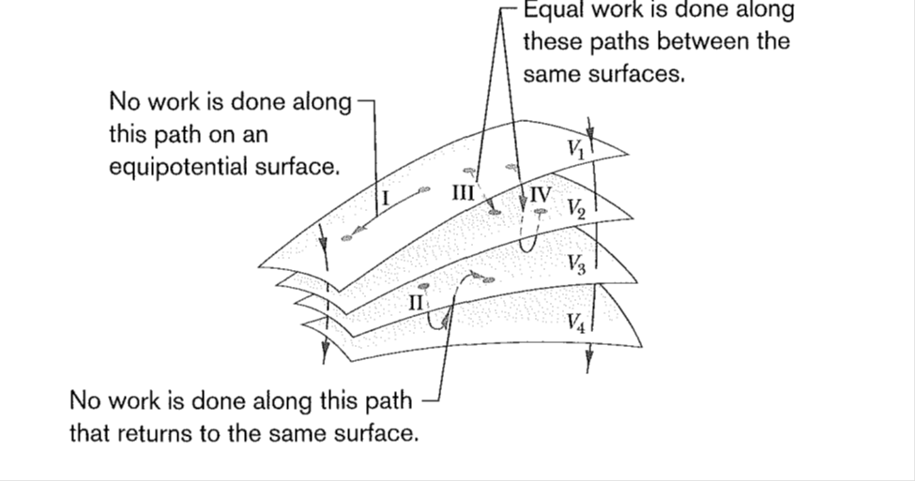
Equipotential Surfaces:
Adjacent points that have the same electric potential form an equipoteutial surface, which can be either an imaginary surface or a real, physical surface. No net work W is done on a charged particle by an electric field when the particle moves between two points A and B on the same equipotential surface.
Equipotential surface

Slide 12
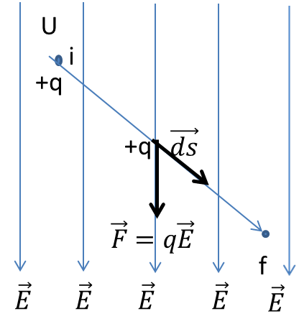
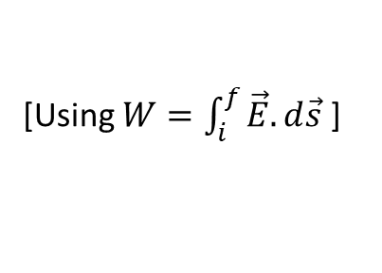

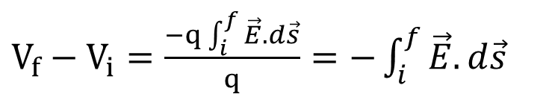
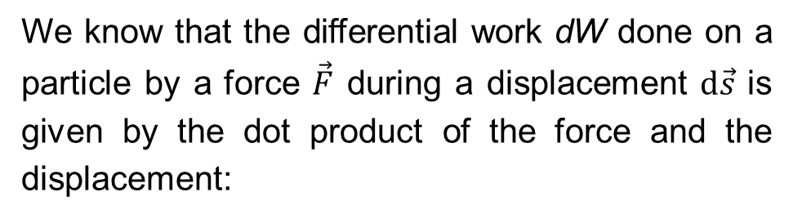
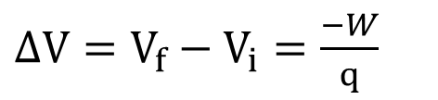

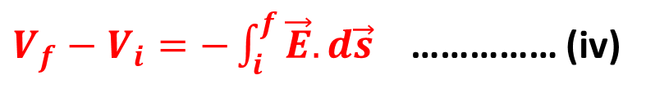
Calculating the Potential from the Field
We know that the differential work dW done on a particle by a force $\vec{F}$ during a displacement $d\vec{s}$ is given by the dot product of the force and the displacement:
$dW=\vec{F}.d\vec{s}=q\vec{E}.d\vec{s}$
The total work W done on the particle by the field as the particle moves from point i to point f,
$W=\int_{i}^{f}{dW}=q\int_{i}^{f}{\vec{E}.d\vec{s}}$
The work done by the electrostatic force in terms of potential difference:
$∆V=V_{f}−V_{i}=\frac{−W}{q}$
$V_{f}−V_{i}=\frac{−q\int_{i}^{f}{\vec{E}.d\vec{s}}}{q}=−\int_{i}^{f}{\vec{E}.d\vec{s}}$
[Using $W=\int_{i}^{f}{\vec{E}.d\vec{s}}$ ]
Finally,
$V_{f}−V_{i}=−\int_{i}^{f}{\vec{E}.d\vec{s}}$ …………… (iv)

Slide 13
THANK YOU

